Slide 1

presidential Polls: 2016 v. 2020
Group 4

Slide 2
Group Members
Stuart Hunter
Shahrzad Khoobyari
Michelle Taymuree
Victor Tran

Slide 3
Background: 2016 General Election v 2020 General Election
Initial topic did not have retrievable data to analyze
Team pivoted to a current event topic
Team landed on examining data from the 2016 general election and comparing this to the 2020 general election
Two data sources
US 2016 General Election Results by State and County (from Data World)
US 2020 General Election Polling Data (from FiveThirtyEight)

Slide 4
“E” - Extract
Data files in csv format
Two data sources
US 2016 General Election Results by State and County (from Data World)
US 2020 General Election Polling Data (from FiveThirtyEight)
Used Jupyter Notebook and Pandas to:
Read the files
Create dataframes
Merge the data

Slide 5
“T” - Transform
Data clean up performed
The following columns were removed:
Start and Stop time stamps
Internal polling information
Free text “notes”
URL addresses
Questionnaire numbers
Polling IDs
Eliminated incomplete polling data
Similar data between the two csv files were subsequently put into dataframes
Renamed columns

Slide 6
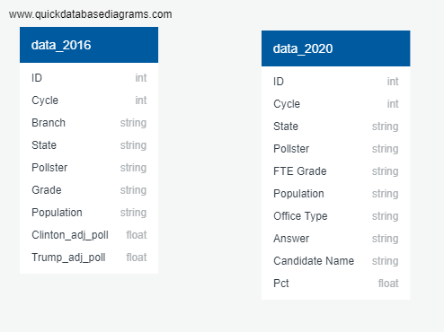
“L” - Load
SQL/pgAdmin tables were created
Data is relational
Tabular form for ease of analysis
Familiarity with SQL
MongoDB was not utilized
Data did not need to be scaled
Poll data from two election cycles limited to participating population

Slide 7
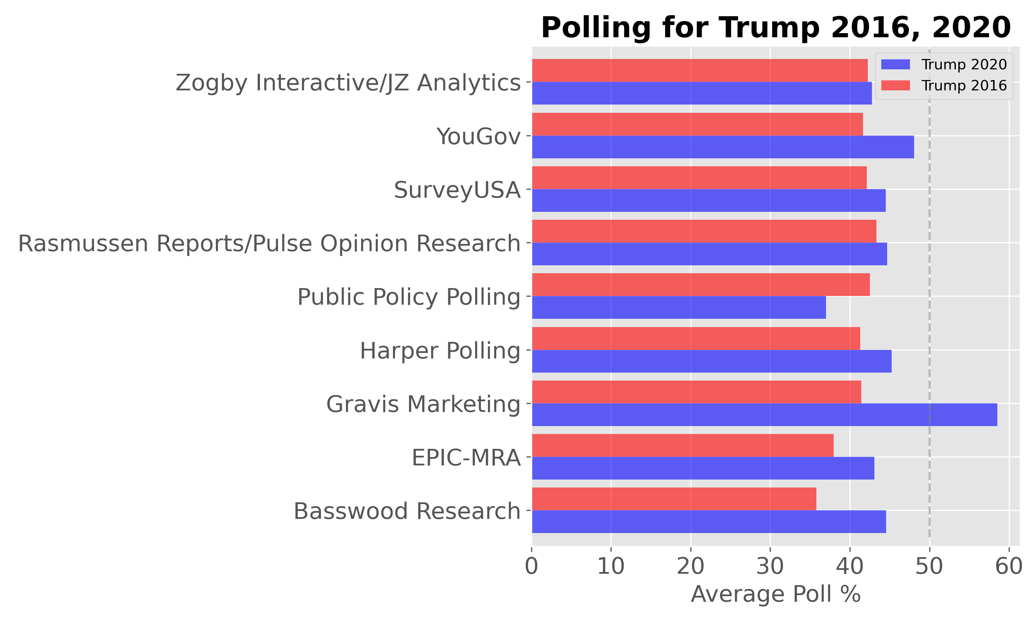
Data Analysis

Slide 8
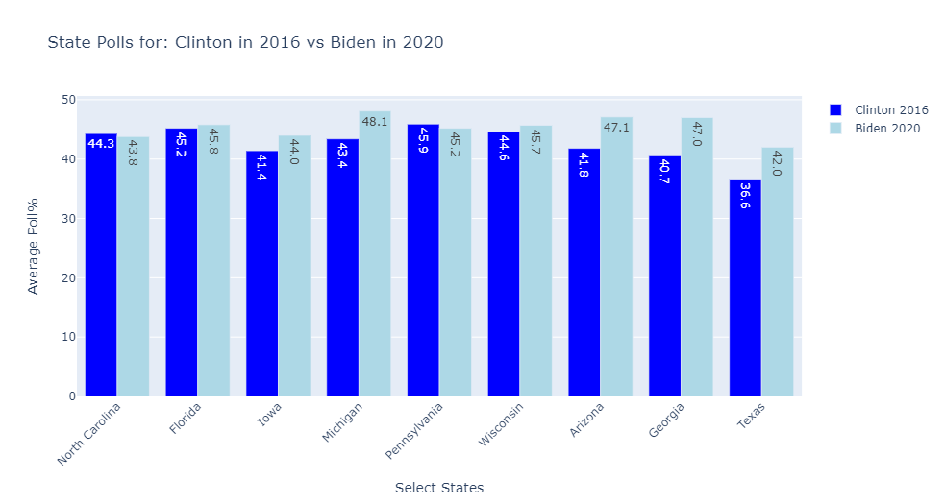
Data Analysis

